Slide 1
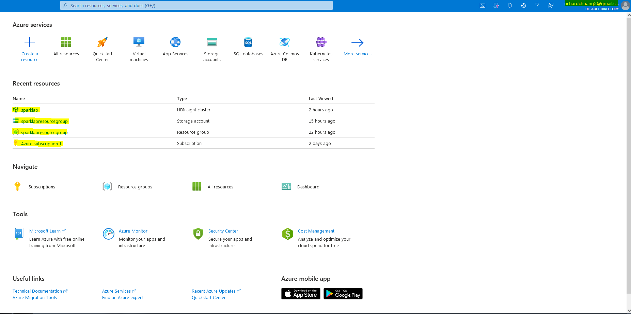
Step 1: Create the Sparklab/sparklabresource group

Slide 2
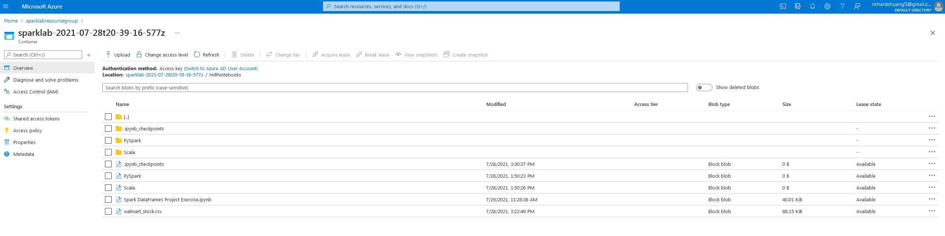
Step 2: Upload files into Azure

Slide 3
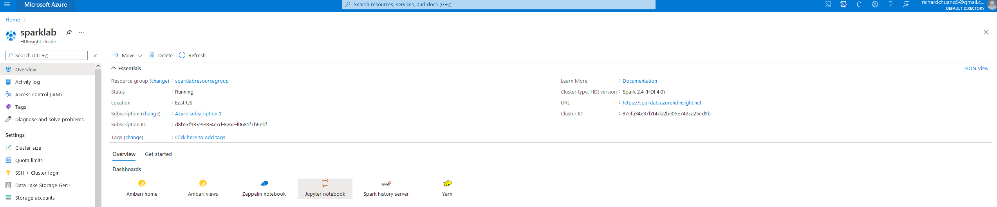
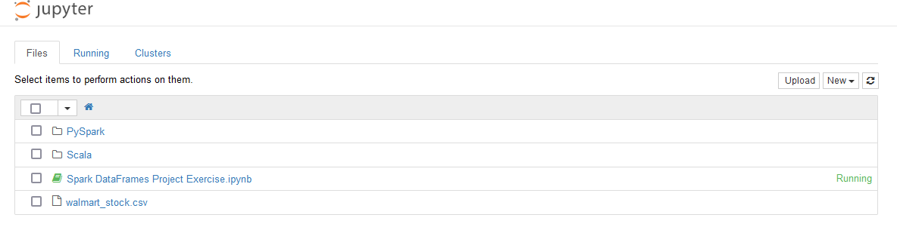
Step 3: Use Jupyter/show files in Jupyter

